Slide 1
Neuro-Symbolic AI
By Maria Cioclov
Alexandru Moise
Annemarie Messner

Slide 2
What is Neuro-Symbolic AI?
Neural Networks
Symbolic Artificial Intelligence
Neuro-Symbolic AI
Requires huge amounts of data for learning
Are limited in their ability to interpret
Entirely based on rules,
Requiring the straightforward installation of behavioral aspects and human knowledge into computer programs
Inaccurate and overpriced (when more and more rules are added to the system).
Uses symbolic reasoning along with the deep learning neural network architecture
High accuracy
Data efficiency
Knows what to use

Slide 3
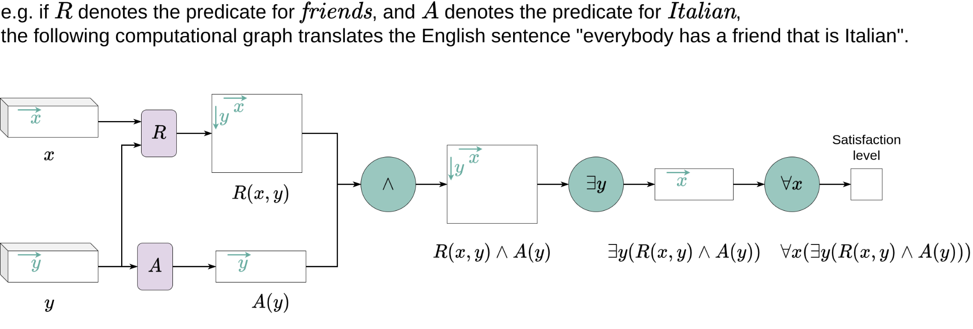
What are Logic Tensor Network?

Slide 4



The problem we aim to solve
The Dataset: Answers for 60 personality questions, along with the results.
Each answer in the dataset has 5 possible values:
-3: Fully disagree
-2: Partially disagree
-1: Slightly disagree
0: Neutral
1: Slightly agree
2: Partially agree
3: Fully agree
For simplicity, we will train our LTN on 2000 entries of 3 different personalities: ISTJ (Logistician), ESFP (Entertainer), ENTP (Debater).

Slide 5
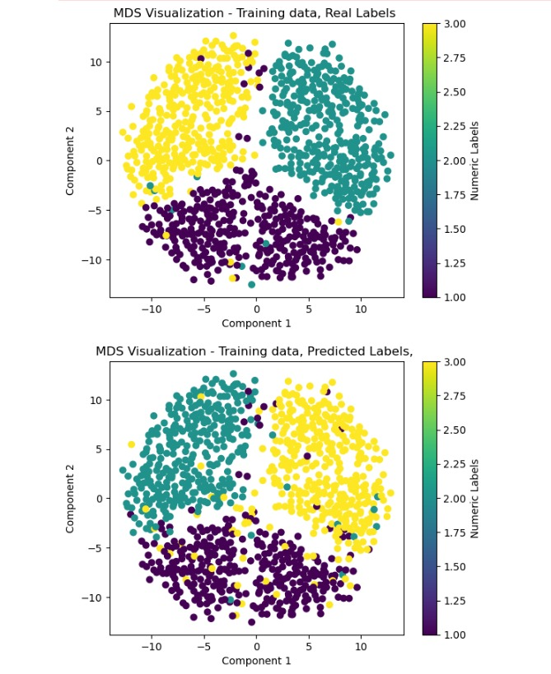
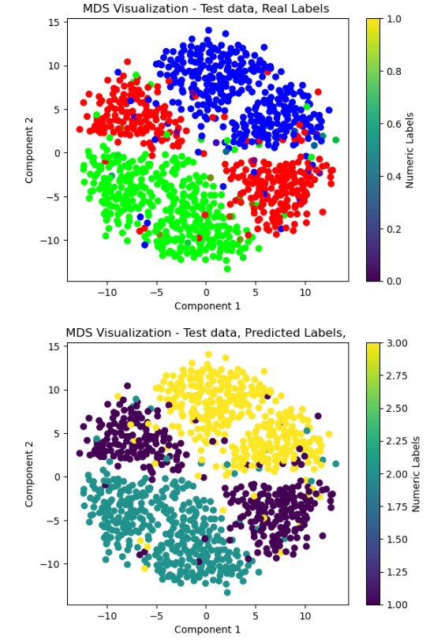
Approach #1

Slide 6
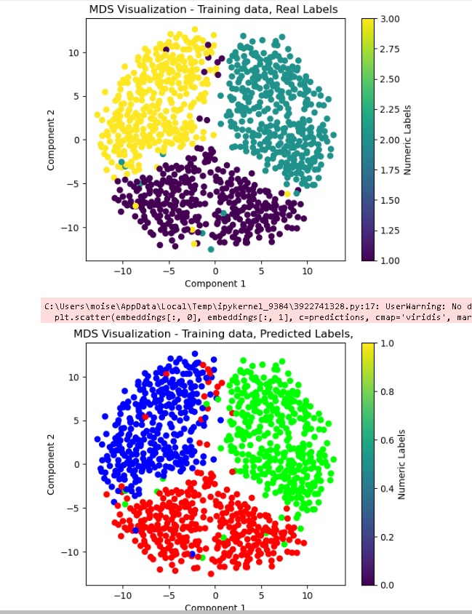
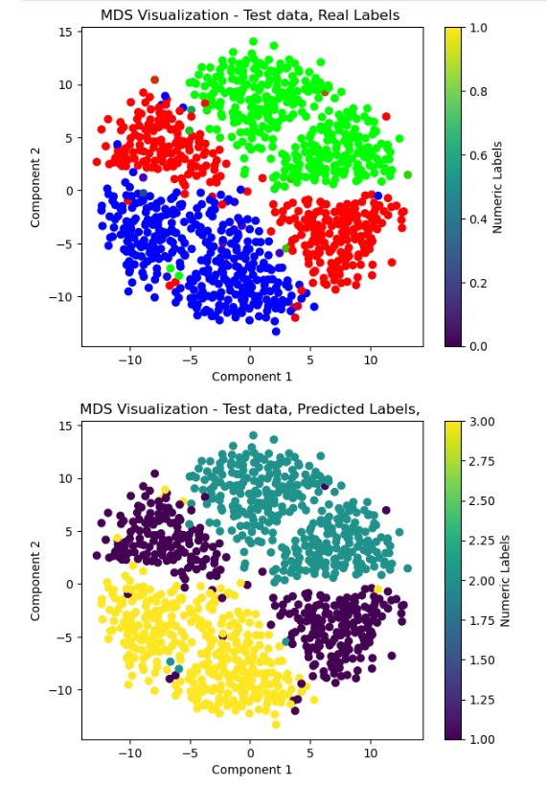
Approach #2

Slide 7
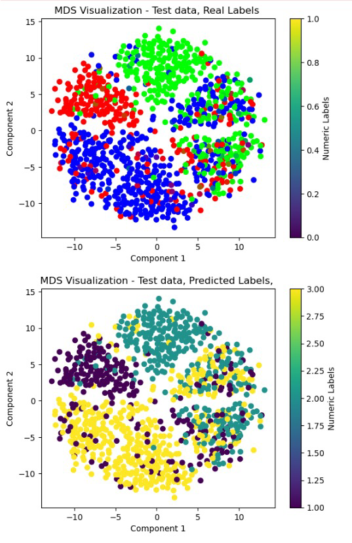
Approach #3

Slide 8
Conclusions
What we learned:
We learned about Neuro-Symbolic AI and its uses
We learned how to use Logic Tensor Networks
What we accomplished:
We implemented a clustering algorithm
We noticed that data randomization directly affects the training process
Tips for future work:
Save the model if it works
Try different LTN classifiers

Slide 9
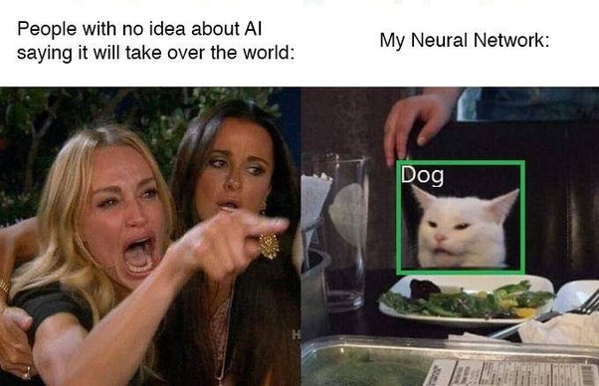
Thanks for watching!

